Slide 1
Advanced Computational Methods in Geotechnical Engineering
Lecture
April 23, 2009

Slide 2
4.4 DISCRETIZATION OF THE DOMAIN
The first step of any finite element analysis involves the discretization of the irregular domain into smaller and regular subdomains, known as finite elements.
This is equivalent to replacing irregular domain of infinite degrees of freedom by a system having finite degrees of freedom.
Efficient methods of FE discretization require some experience.

Slide 3
For large problems with complex geometries, discretization based on manual procedures requires considerable effort and time on the part of the analyst.
Many computer programs employ automatic mesh generation scheme.
Example: Geo-Studio 2004 (or Geoslope)
http://www.geo-slope.com/

Slide 4
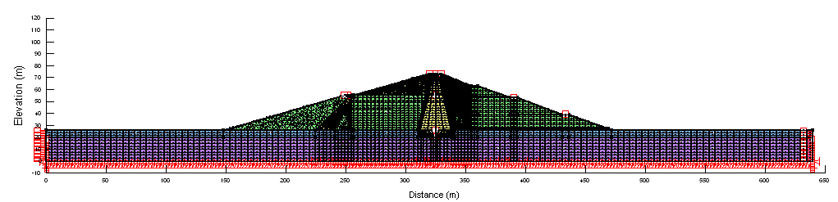
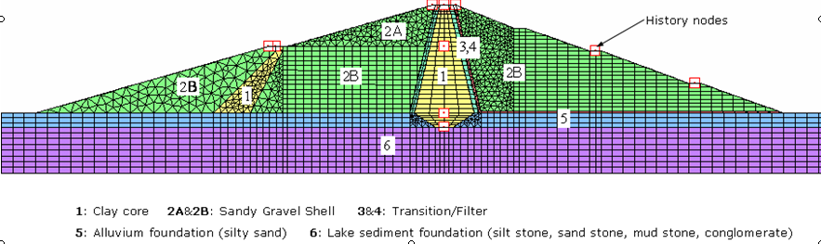
Dynamic Analysis – Tendaho Dam
F.R.L. (408 m)
Finite Element Model Used For the Analysis

Slide 5
4.4.1 Basic Element Shapes
The shapes, sizes, number, and configurations of the elements must be chosen carefully.
Mostly the choice of the type of the element depends on the geometry of the body.
For the discretization of one-dimensional structural components (eg. deformation of a bar under axial load) one-dimensional or line elements are used.

Slide 6
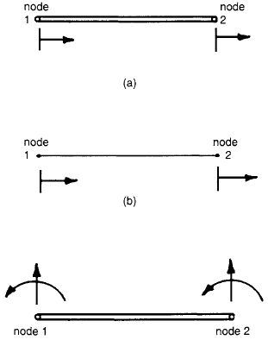
Simple Analysis:
- 2 nodes - one at each end with 2 degrees of freedom.
Beam Analysis:
- transverse displacement & its derivative are chosen as unknowns at each node.
S. S. RAO

Slide 7
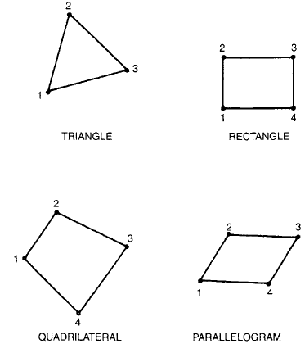
For the discretization of two-dimensional problems two-dimensional elements are used..
- The basic element useful for 2D analysis is the triangular element.

Slide 8
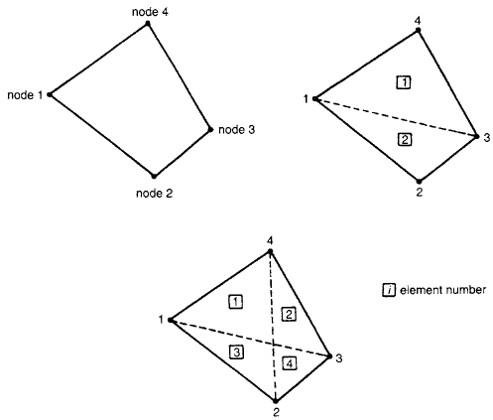
A quadrilateral element as an assemblage of two or four triangular elements.

Slide 9
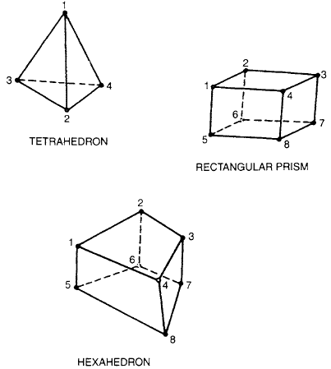
For the discretization of a solid mass of material, three -dimensional elements are used.

Slide 10
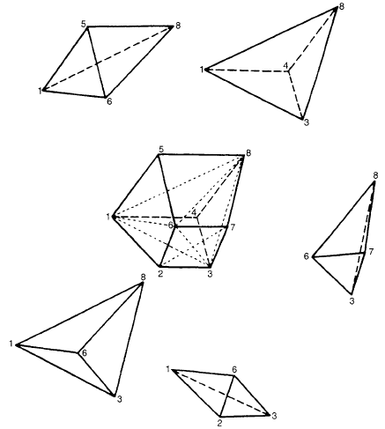
- The basic element in 3D analysis is the tetrahedron element.
A hexahedron element as an assemblage of five tetrahedron elements.

Slide 11
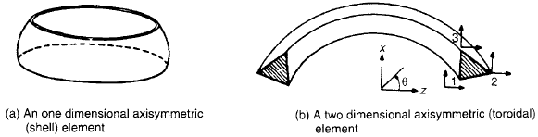
Some problems, which are actually three-dimensional, can be described by only one or two independent coordinates.
Axisymmetric Elements

Slide 12
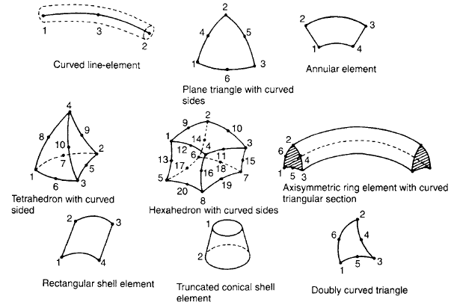
For the discretization of problems involving curved geometries, finite elements with curved sides are useful.

Slide 13
Modeling curved boundaries became possible due to the addition of midside nodes.
Finite elements with midside nodes are called higher order elements – while those without are called linear elements.

Slide 14
4.4.1 DISCRETIZATION PROCESS
The following points should be considered in FE discretization process:
Type of Elements
Often the type of elements to be used will be evident from the physical problem itself.
Eg. for the analysis of a truss – obviously the bar or line elements are used.

Slide 15
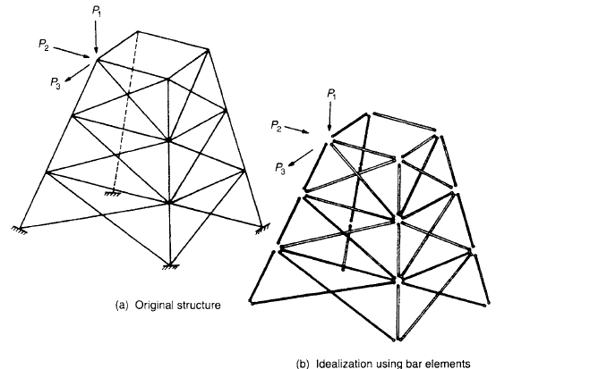

Slide 16
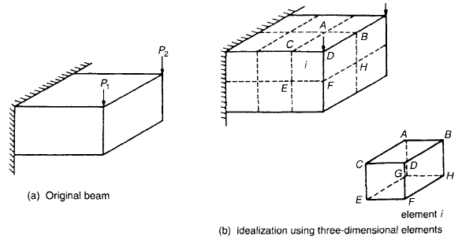
- Similarly, in the case of stress analysis of the beam shown in the figure below, the finite element idealization can be done using three-dimensional solid elements

Slide 17
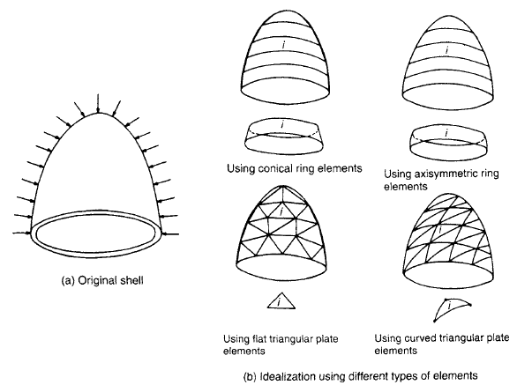
However, in some cases, the type of elements to be used may not be apparent.
A thin-walled shell under pressure – idealization using different types of elements

Slide 18
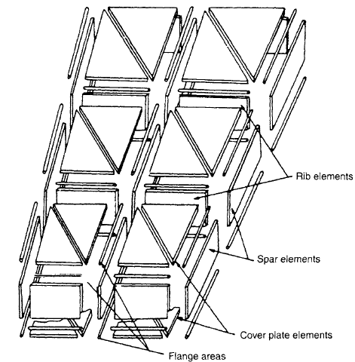
In some problems, the given body cannot be represented as an assemblage of one type of elements.
Idealization of an aircraft wing using different types of elements

Slide 19
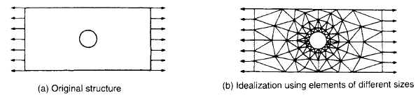
Size of Elements
The size of elements influences the convergence of the solution directly and it has to be chosen with care.
Sometimes we may have to use elements of different sizes in the same body.
Area of stress concentration

Slide 20
Aspect Ratio –related to size
Aspect Ratio: in 2D elements ratio of larger to smaller dimension.
ratio nearly unity generally yields good results.
Location of Nodes
If the body has no abrupt changes in geometry, material property, and external conditions (like loads), the body can be divided into equal subdivisions with uniform spacing of nodes.

Slide 21
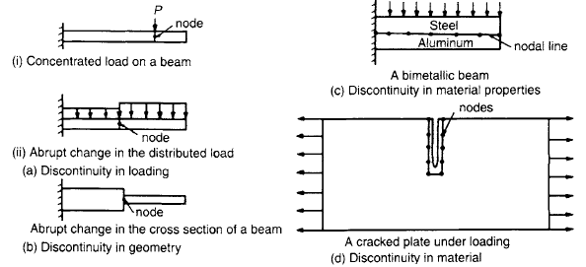
However, If there are any discontinuities in the problem, nodes have to be introduced at these discontinuities.
Location of nodes at discontinuities

Slide 22
Number of Elements
is related to the accuracy desired, size of elements, and the number of degrees of freedom involved.
An increase in the number of elements generally means more accurate results. However, there will be a certain number of elements beyond which the accuracy will not be improved any significantly.

Slide 23
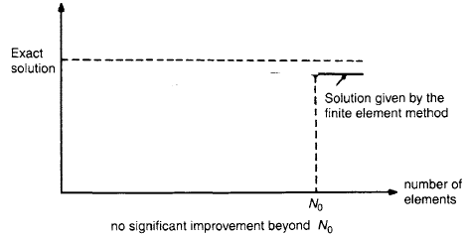
Effect of varying the number of elements

Slide 24
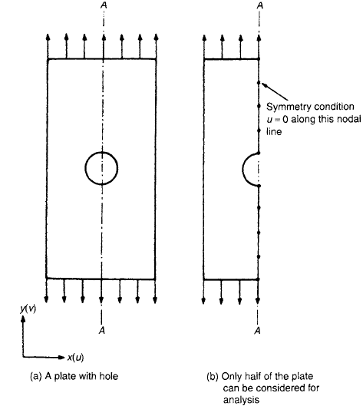
Simplification due to Symmetry
If the configuration of the body and the external conditions are symmetric, half of the body may be considered.
A plate with a hole with symmetric geometry & loading

Slide 25
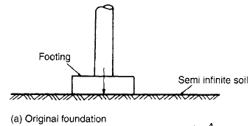
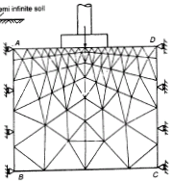
Finite Representation of Infinite Bodies
It is sometimes necessary to describe a domain of infinite extent. Examples are found in Geomechanics in which the rock or soil mass is assumed to be infinitely large.
roller boundary
u=0
Eg.: Geo-Studio 2004
fixed boundary
u=v=0
Idealization of the semi infinite medium

Slide 26
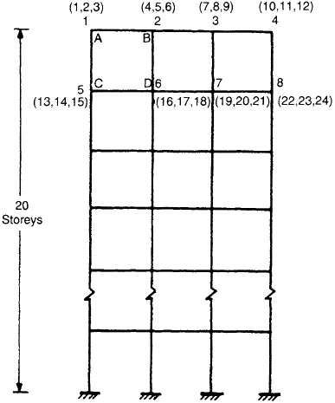
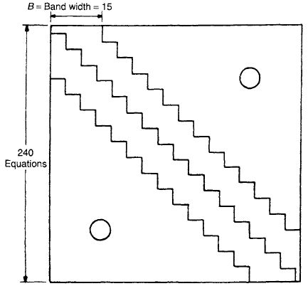
4.4.2 NODE NUMBERING SCHEME
FE analysis of practical problems leads to matrix equations in which the matrices involved will be banded.
Entire stiffness matrix = 240×240
= 57,600 locations.
Band width of overall stiffness matrix =15
15×240 = 3,600 locations

Slide 27
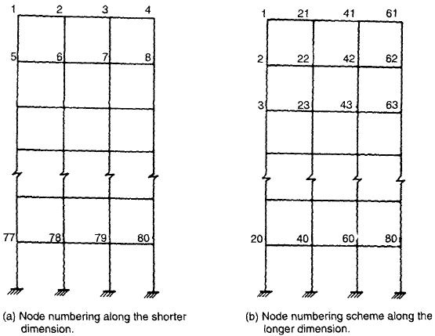
Band width (B) = (D+1)×f
D : maximum difference between the numbered degrees of freedom at ends of any member.
f : number of degrees of freedom at each node.
Shorter Span
D = 4
B = (4+1)×3 = 15
Longer Span
D = 20
B = (20+1)×3 = 63

Slide 28
4.4.3 AUTOMATIC MESH GENERATION
Automatic mesh generation algorithms, capable of discretizing any geometry without user intervention have been developed.
An automatic mesh generation program generates the locations of the node points and elements, labels the nodes and elements, and provides the element-node connectivity relationships.
The most common methods used in the development of automatic mesh generators are the tesselation method and the octree method (or quadtree method for 2D).

Slide 29
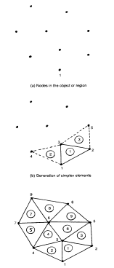
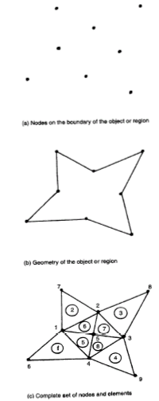
Mesh generation using tesselation method

Slide 30
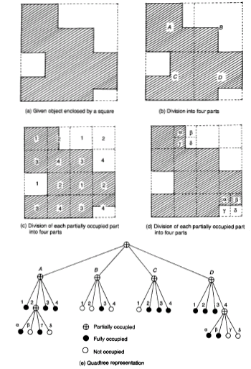
Mesh generation using quadtree method

